Slide 1
INT 306 Database Management System
Lecture 7
Relational Algebra Part 1

Slide 2
Formal Relational Languages
Two mathematical Query Language form the basis for “real” languages (e.g., SQL), and for implementation:
Relational Algebra: operational, very useful for representing execution plans
Relational Calculus: declarative , lets users describe what they want, rather than how to compute it

Slide 3
Preliminaries
A query is applied to relation instances
The result of a query is a relational instance
Positional v.s. name-ﬁeld notation:
Positional notation: easier for formal deﬁnitions
Named-­ﬁeld notation: more readable

Slide 4
Example
Schema Example:
Sailors(sid : integer, sname : string ,rating : integer, age: real)
Boats(bid: integer, bname: string, color: string)
Reserves(sid: integer, bid: integer, day: date)
Instance s1 of sailors Instance s2 of sailors Instance r1 of reserves
sid | sname | rating | age
22 | Lia | 8 | 40
23 | Ruby | 8 | 37
24 | John | 6 | 34
sid | sname | rating | age
23 | Ruby | 8 | 37
25 | Lee | 6 | 35.5
27 | Robin | 9 | 40
29 | Jack | 7 | 35.5
sid | bid | day
22 | 101 | 30/07/2018
23 | 104 | 2/08/2018

Slide 5
Relational Algebra
Queries in algebra are composed using a collection of operators
– Operators can be unary or binary
Every operator in the algebra accepts (one or two) relation instances as arguments, and returns a relation instance as the result

Slide 6
Selection
Selection (σ) selects subset of rows from relation
Expression:
σ rating>7 (S2)
Schema of the result of a selection
= schema of the input relation instance
sid | sname | rating | age
23 | Ruby | 8 | 37
27 | Robin | 9 | 40

Slide 7
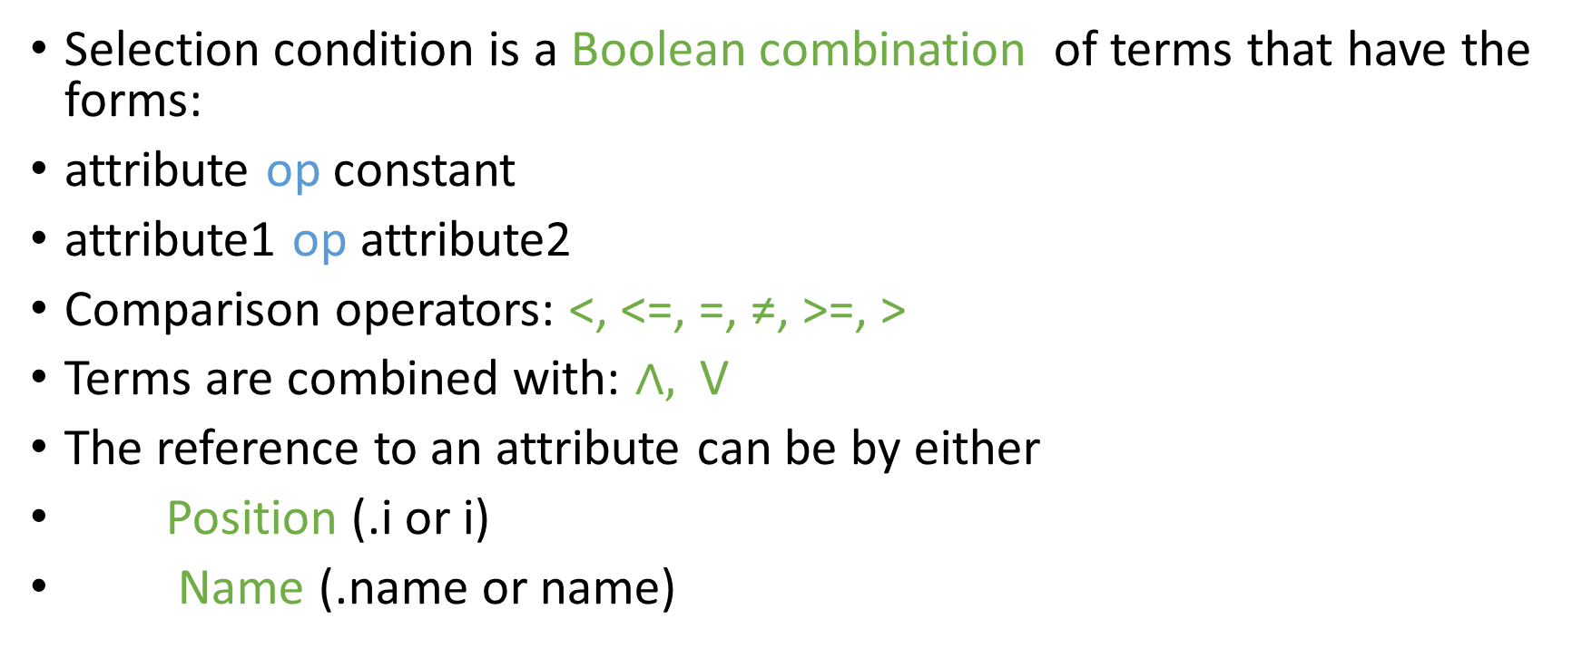
Selection (cont.)
Selection condition is a Boolean combination of terms that have the forms:
attribute op constant
attribute1 op attribute2
Comparison operators: <, <=, =, ≠, >=, >
Terms are combined with: $∧,$ V
The reference to an attribute can be by either
Position (.i or i)
Name (.name or name)

Slide 8

Projection
Projection (π) deletes unwanted columns from relation
Example
π sid, sname (S2)
sid | sname
23 | Ruby
25 | Lee
27 | Robin
29 | Jack
The other ﬁelds are projected out
The schema of the result of a projection is determined by the ﬁelds that are projected

Slide 9
Projection(cont..)
Duplicates are eliminated
Example:
πage(S2)
Return:
Follows deﬁnition of relation: set of tuples
Real systems often omit this step
age
37
40
35.5

Slide 10
Selection and Projection
We can combine σ and π together
Example:
π sname, rating (σ rating>7 (S2))
Return:
The order of applying the operators is Selection------→ Projection.
sname | rating
Ruby | 8
Robin | 9

Slide 11
Set Operation: Union
Union (⋃)
R ⋃ S
Returns a relation instance containing all tuples that occur in either relation instance R or relation instance S (or both)
R and S must be union-­compatible:
Same number of ﬁelds
Corresponding ﬁelds have the same domain.

Slide 12
Set Operation: Union (cont.)
Example: S1 ⋃ S2
sid | sname | rating | age
22 | Lia | 8 | 40
23 | Ruby | 8 | 37
24 | John | 6 | 34
25 | Lee | 6 | 35.5
27 | Robin | 9 | 40
29 | Jack | 7 | 35.5

Slide 13
Set Operation: Intersection
Intersection (⋂):
R ⋂ S
Returns a relation instance containing all tuples that occur in both R and S
The relations must be union-­‐compatible too
Example: S1 ⋂ S2
sid | sname | rating | age
23 | Ruby | 8 | 37

Slide 14
Set Operation: Set-­‐diﬀerence
Set-­‐diﬀerence (−):
R − S
Returns a relation instance containing all tuples that occur in R but not in S
The relations must be union-­‐compatible too
Example: S1 − S2
sid | sname | rating | age
22 | Lia | 8 | 40
24 | John | 6 | 34

Slide 15
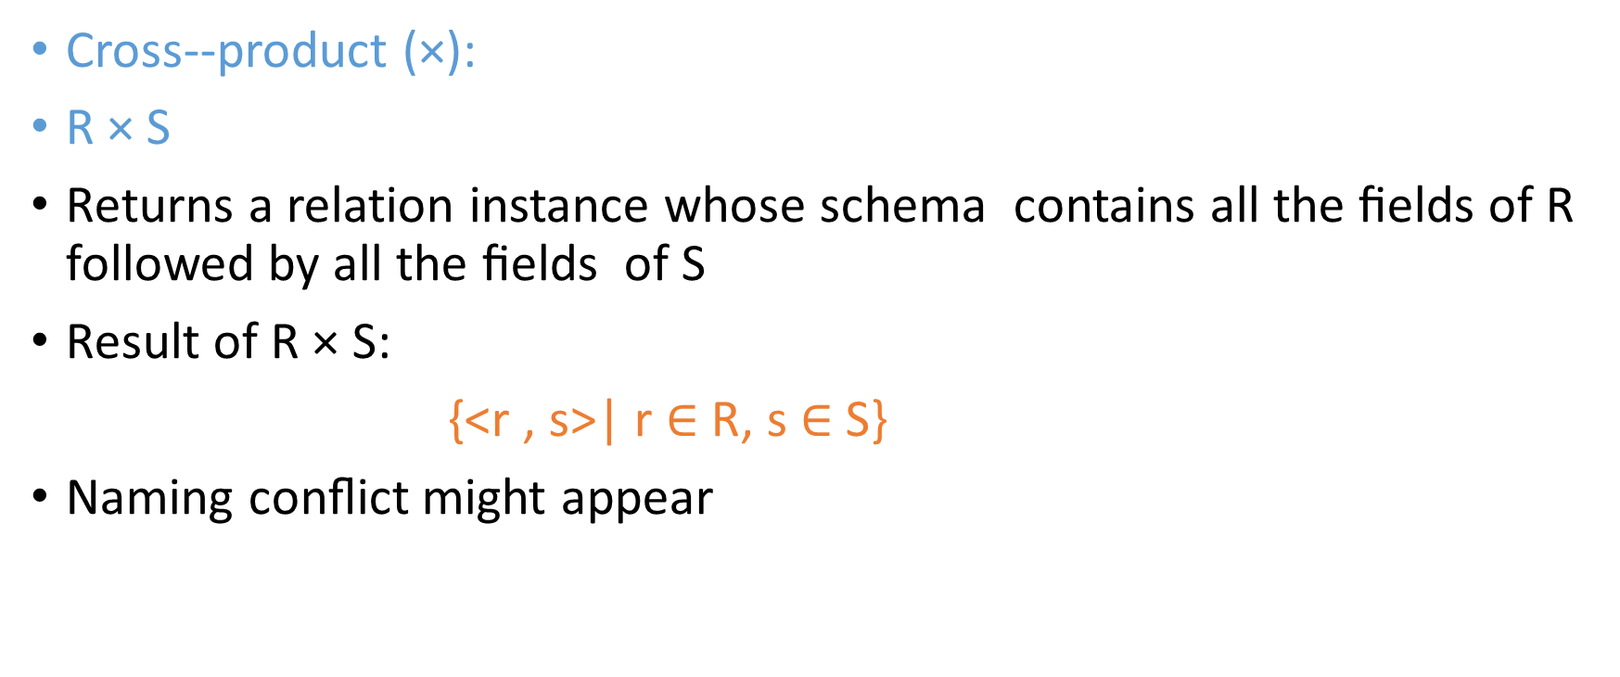
Set Operation: Cross-­‐product
Cross-­‐product (×):
R × S
Returns a relation instance whose schema contains all the ﬁelds of R followed by all the ﬁelds of S
Result of R × S:
{<r , s>| r $∈$ R, s $∈$S}
Naming conﬂict might appear

Slide 16
Set Operation: Cross­‐product (cont.)
Example: S1 × R1
sid | sname | rating | age | (sid) | bid | day
22 | Lia | 8 | 40 | 22 | 101 | 30/07/2018
22 | Lia | 8 | 40 | 23 | 104 | 02/08/2018
23 | Ruby | 8 | 37 | 22 | 101 | 30/07/2018
23 | Ruby | 8 | 37 | 23 | 104 | 02/08/2018
24 | John | 6 | 34 | 22 | 101 | 30/07/2018
24 | John | 6 | 34 | 23 | 104 | 02/08/2018

Slide 17

Think!
Instance s1 of sailors Instance s2 of sailors Instance r1 of reserves
Find the sailor’s name who reserved boat with bid=‘104’
$π_{sname}$($σ_{S.sid=r1.sid∧r1.bid=104 }(\left(s1Us2\right)×r1))$
sid | sname | rating | age
22 | Lia | 8 | 40
23 | Ruby | 8 | 37
24 | John | 6 | 34
sid | sname | rating | age
23 | Ruby | 8 | 37
25 | Lee | 6 | 35.5
27 | Robin | 9 | 40
29 | Jack | 7 | 35.5
sid | bid | day
22 | 101 | 30/07/2018
23 | 104 | 2/08/2018

Slide 18
Task
Consider the following schema
Flight( FlightNo: Number, FlightName: String, Source: String, Destination: String)
Display the information of the flights whose FlightNo is greater than 1105.
Display the FlightName for which the Source is London
Display the information of all the flight going (Destination)to Singapore

